Slide 1

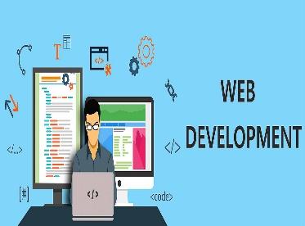
WEB DEVELOPMENT
(Understanding The Basics)
Lecture-1

Slide 2
Today’s Agenda
What You Should Know Before Joining This Course ?
What Is Web Development ?
Important Terminologies
Client-Server
Front End Development
Three Pillars Of Front End Development-HTML,CSS,JS
Back End Development
Full Stack Development
Course Outline

Slide 3
What You Should Know ?
To start learning Web Development , there is no strict pre-requisite
You just have to be familiar with how to use browser for surfing the internet
No specific programming language knowledge is needed.
Just basic knowledge in C/C++ is more than sufficient and that too will be needed when we will learn JavaScript

Slide 4
What Is Web Development ?
Web development is basically the tasks associated with developing websites/web applications for hosting via internet.
When you view a website/web application on the web in a browser, it is because of all the processes involved in web development.

Slide 5
What Is A Web Application ?
A web application which most of the non IT people refer to as a website , is a collection of web pages .
In technical terms , a Web application (Web app) is a program that executes on a server on the Internet and it’s output is delivered to the client i.e. browser

Slide 6
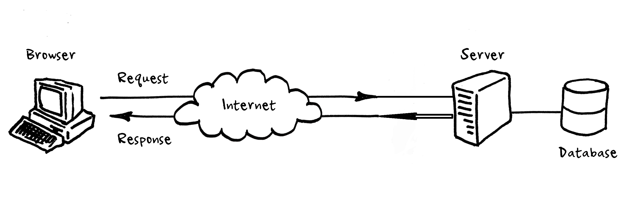
What Is A Web Application ?

Slide 7
What Are Servers And Clients ?
Server : The Servers are computers that are used to host websites and store the website files. These servers are connected to the giant network called the World Wide Web.
Clients: The Clients are computers that have browsers running and they load the website files via internet connection

Slide 8
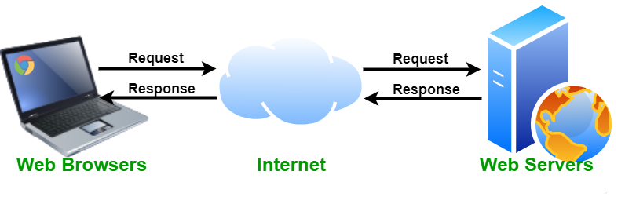
What Are Servers And Clients ?

Slide 9
What Is A Web Site ?
A website, is a set of web pages built using HTML, CSS, and JavaScript that contains static information in the form of text, images, audio, and video content.
Websites are generally meant to present information to visitors about a business , a person , an organization etc.
Examples of websites include News papers websites, tutorial websites ,personal websites etc.

Slide 10
Web Site V/s Web Application
Website | Web Application
Convey static information to the visitor i.e. every user sees the same information | Convey dynamic information to the visitor i.e. every user sees different information based upon his input
Provide a one-way communication where a user visits a website, goes through the information on a website and leaves | Provides a two-way interaction wherein a user performs certain actions on a web page which generates responses from the server.
Can be developed by simply using front-end technologies like HTML, CSS and JS | Alongwith front-end technologies they also require support of a backend technologies like Python, PHP, Java , Go, C# etc.
Examples are bhaskar.com, stroustrup.com , tutorialspoint.com etc | Examples are amazon.in, facebook.com , gmail.com etc

Slide 11
Web Application Architecture
A Web application is a complex piece of software.
It consists of many components like the user interface, a login-screen, a products display screen, the database, etc.
It’s actually easier to define web application architecture with the help of a diagram , present on next slide that shows how everything fits together

Slide 12
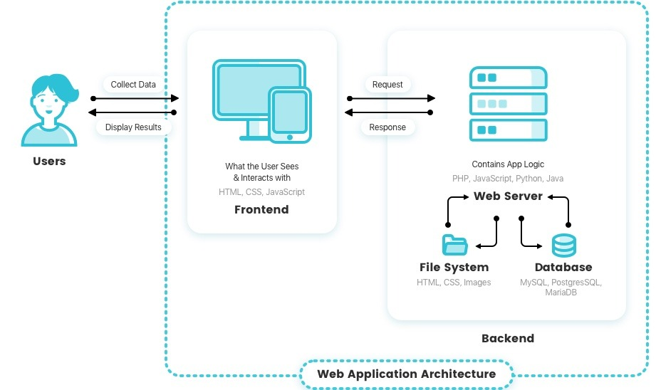
Web Application Architecture

Slide 13
Web Application Components
Every web application , primarily contains 2 very important components and these are called :
Front End
AND
Back End

Slide 14
What Is Front End ?
The front end , also called client side of a web application , is everything that the user sees and interacts within inside their browser.
It includes everything the user experiences directly: from text and colors to buttons, images etc.
The main purpose of the client side is to collect data from users.

Slide 15
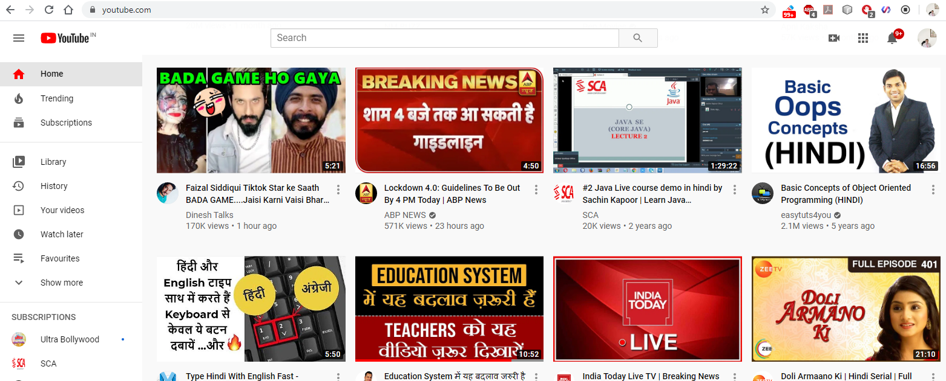
What Is Front End ?

Slide 16
What Is Front End Made Up Of ?
The front end is built with 6 key technologies :
HTML
CSS
JavaScript
Bootstrap
Ajax
jQuery
The three very important of them are HTML , CSS and JavaScript

Slide 17
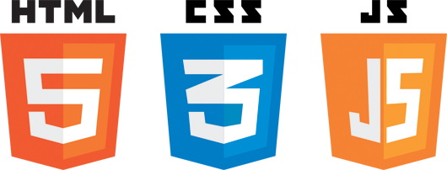
The Three Key Players In Front End

Slide 18
The Three Key Players In Front End
HTML (HyperText Markup Language)
CSS (Cascading Style Sheets)
JavaScript
It is the backbone of the Web. Every website you visit is built with HTML.
It takes care of all the structure and content
It is what controls the look and feel of the page.
CSS sets the colors, fonts, background images, and even the way the page
is laid out
It is a programming language commonly used to create interactive effects
within web browsers.

Slide 19
The Three Key Players In Front End
In short we can remember that:
HTML is for content
CSS is for presentation
JavaScript is for behaviour

Slide 20
The Three Key Players In Front End

Slide 21
What Is Back End ?
Back-end development refers to the server-side development.
It is the term used for the behind-the-scenes activities that happen when performing any action on a web application.
Backend developer focuses on databases, business logic, and the architecture of web application.

Slide 22
What Is Back End ?
Think for a minute, what happens when you fill your username and password in Gmail’s login page.
All the data you filled goes to the gmail server
At the server , there is some piece of code which receives this data , performs a search query on the database and retrieves the result.
Based on the result of the query , it sends the response login accepted or login failed to the browser.
And the browser displays this result to you.

Slide 23
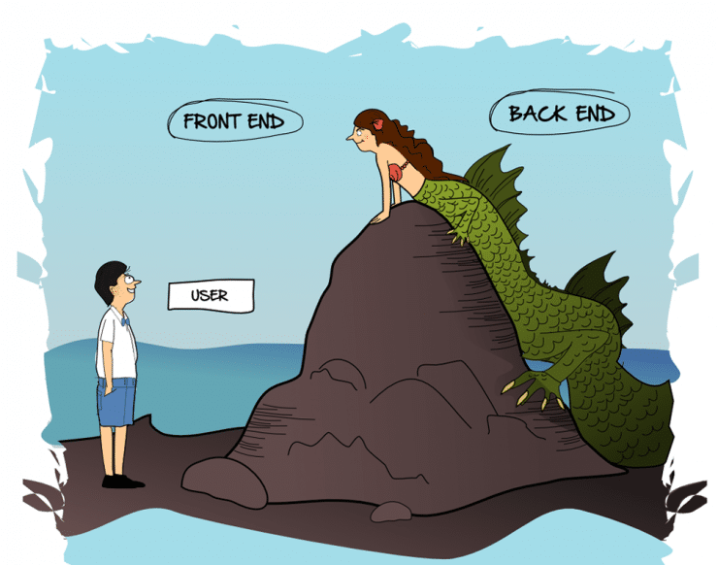
Front End V/s Back End

Slide 24
What Is Back End Made Up Of ?
A backend developer needs to understand 2 very important elements :
A server side programming language like Python , Java, PHP , Ruby, C# etc
AND
Database Management System like Oracle, MySQL etc.

Slide 25
What Full Stack Web Development Contains ?
Full stack developers work with both the front and back end of a web application.
They’re familiar with HTML, CSS, JavaScript and one or more back end language/framework which in our case are JEE or Django.

Slide 26
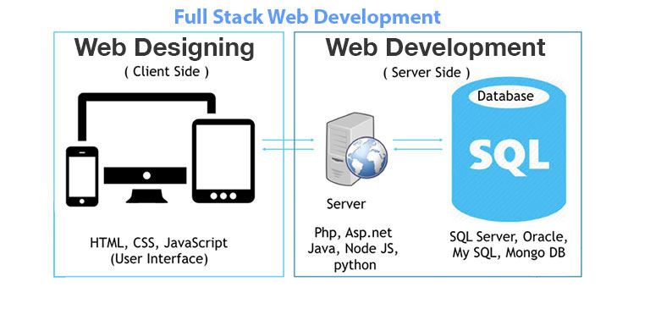
What Full Stack Web Development Contains ?

Slide 27
What We Will Learn ?
If you join only Front End Web Development course then you will learn Front End Technologies as a part of the course.
That means , we will be covering :
HTML
CSS
JavaScript
React JS
Bootstrap
Ajax
jQuery

Slide 28
If You Know Core Java . . .
You can join Full Stack Web Development through Java EE, which will cover :
Finally all this will be incorporated in a FREE PROJECT
Course Duration : Around 55 hours
Client Tier | Business Tier | Data Tier
HTML | Servlets | JDBC
CSS | JSP | Advance JDBC
JavaScript | Session Management | Design Pattern
React JS | Java Beans | DAO Pattern
Ajax & Jquery | EL | MVC Pattern
Bootstrap | Custom Tags

Slide 29
If You Know Python. . .
You can join Full Stack Web Development through Django , which will cover :
Finally all this will be incorporated in a FREE PROJECT
Course Duration : Around 50 hours
Front End | Back End
HTML | Django Models | Model Forms
CSS | Django Views | Url Routing
JavaScript | Django Templates | Administration
React JS | ORM
Ajax & jQuery | User Management
Bootstrap | Django Forms

Slide 30
Batch Schedule
Class Timing (For Front End): 8:00 PM on Tue,Thu,Sat
The next class is on Thursday , 29th Oct @ 8:00 PM
Topic: HTML
For any query ,please call at 9826086245, 7000521916, 9826686245

Slide 31

Course Fee For Front End Development

